Slide 1

How does ridership data differ between
annual members and casual riders, and how to convert
casual riders into annual riders?
CYCLISTIC BIKE SHARE ANALYSIS
GOOGLE DATA ANALYTICS CASE STUDY
│ KORANKYE EMMANUEL BOADI │ │ Google Data Analytics Certificate Capstone │ │ Divvy Tripps Q1 2019 & Q1 2020 │

Slide 2
AGENDA
01 BUSINESS QUESTION
Why this analysis matters
04 VISUALIZATION
Charts were built in tableau public
02 DATA SOURCES & PREPARATION
Q1 2019 + Q1 2020 datasets
Cleaning process
05 RECOMMENDATION
Three data-backed strategies for marketing
03 KEY FINDINGS
Ride volume, duration, and temporal patterns
06 NEXT STEPS
Proposed path forward

Slide 3
BUSINESS QUESTION
Who is Cyclistic?
A Chicago ride share company founded in 2016 with 5,800 bikes and over 600 docking stations across Chicago. Engages in single ride pass, full-day ride passes and annual memberships.
Two Rider Types
Casual riders purchase single-day rides or full-day passes. Annual members purchase annual subscriptions to access Cyclistic service.
The Business Question
Finance analysts confirm annual members purchase more services and hence are more profitable. The marketing team wants to convert more casual riders into annual riders - but needs to determine how they differ first.
🔍 Key Question: How do annual members and casual riders use Cyclistic service differently?

Slide 4
DATA SOURCES & PREPARATION
Datasets Used
Source : Divvy / Motivate International
Period : Q1 2019 & Q1 2020
Records : ~788K trips
Format : Two CSV files
License : Public, open data license
Data Cleaning Steps
Align column names between 2019 and 2020 schemas
Standardized member_casual labels (subscriber → Member. Customer → Casual)
Converted timestamps and computed ride_length in minutes
Add date, day, month, year and day_of_week columns
Removed negative durations and HR QR quality-control entries
Dropped column names unavailable post 2020 (lat, lng, birthday, gender)

Slide 5
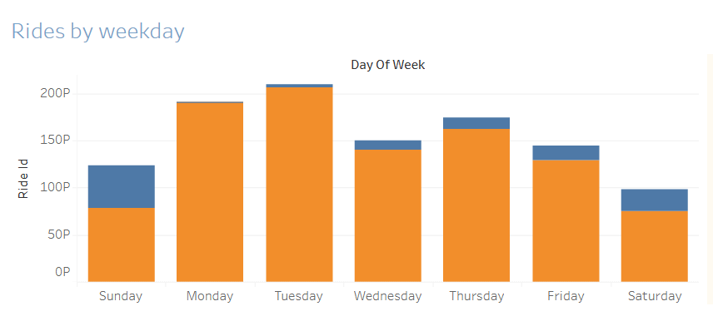
FINDING 1 : RIDES BY DAY OF THE WEEK
Members
Ride most on weekdays – Tuesday through Thursday peak. This is a commuter pattern.
Casual
Surge on weekends (Sat and Sun). Leisure and tourism drive their usage

Slide 6
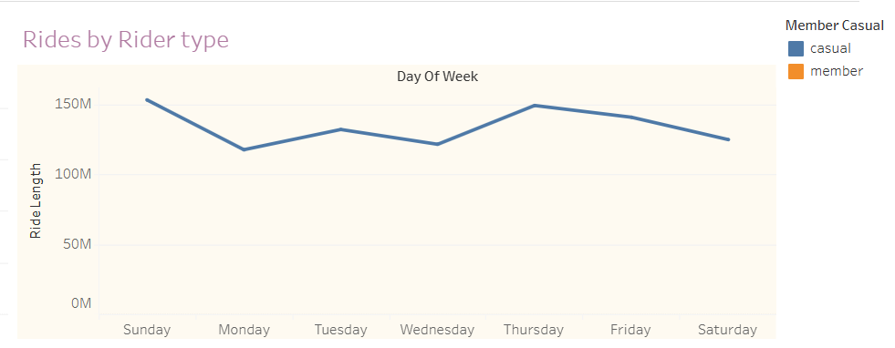
FINDING 2 : RIDES BY RIDER TYPE
~ 52 min
~ 22 min
Casual avg. ride
Nearly 3x longer than members
Members avg ride
Shorter, purposeful commute

Slide 7
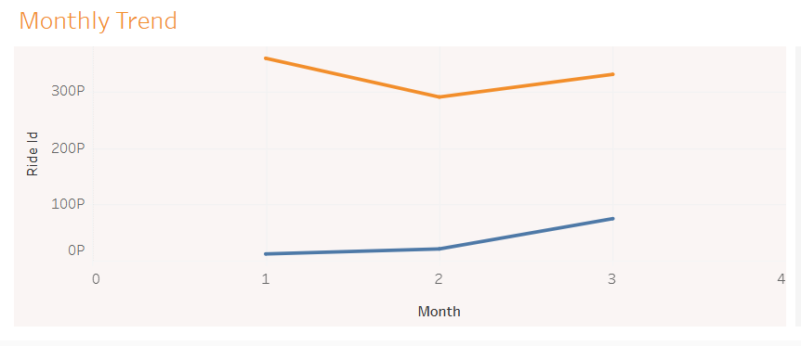
FINDING 3 : MONTHLY AND SEASONAL TRENDS
What this shows
March is the highest month in both years
Members dominate all months in both years
Casual rides rise ~25% YoY in March
Q1 saw a major growth – probably due to pre-COVID growth burst

Slide 8
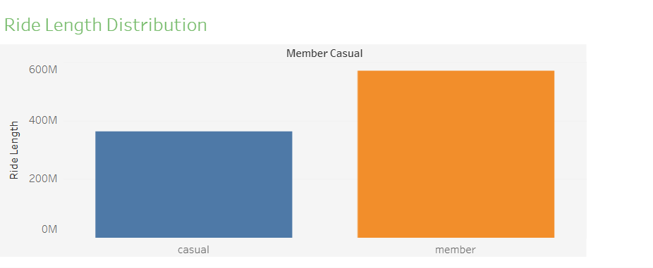
FINDING 4 : RIDER COMPOSITION OVERVIEW
77 %
of all rides taken by
annual members
23 %
of all rides taken by
casual members
3x
longer rides
For casual vs members avg
2x
higher rate
of weekend casual rides

Slide 9

INTERACTIVE TABLEAU DASHBOARD
CYCLISTIC BIKE SHARE DASHBOARD
Built in Tableau Public
Ride by rider type and day of the week
Avg ride duration breakdown by membership category
Monthly ridership trends across Q1 2019 and Q1 2020
Interactive filter for deeper exploration
https://public.tableau.com/app/profile/emmanuel.korankye/viz/GoogleDataAnalyticsCapstoneCyclisticbikeshareanalysis/BikeShareDashboard#1

Slide 10
RECOMMENDATIONS
Weekend conversion campaigns
Casual riders are most active on weekends. Deploy targeted digital ads and in-app prompts on Friday through Sunday highlighting the savings of an annual membership for frequent weekend riders.
01
Ride-Duration Milestone Rewards
Since casual riders take longer trips, introduce a tiered reward: riders who accumulate X minutes per month get a discount on a membership upgrade. This leverages their existing behavior to pull them toward conversion.
02
March Seasonal Push
Ridership — especially casual — surges in March. Launch a time-limited spring membership promotion in late February/early March. Pair it with social media content showcasing Cyclistic for recreation, not just commuting.
03

Slide 11
NEXT STEPS
🗺️
📊
Add GEO Analysis
Expand the dataset
Include full-year data (Q2–Q4) to capture summer peaks and reduce Q1 seasonality bias.
Incorporate station-level data to identify where casual riders start and end their trips — enabling hyper-local marketing.
🧪
A/B Test campaigns
📱
Digital Touchpoints
Run parallel weekend and seasonal membership promos with distinct CTAs to measure conversion rates.
Analyze in-app behavior to identify the moment casual users are most likely to convert (e.g., after their 3rd long ride).

Slide 12
THANK YOU
EMMANUEL BOADI KORANKYE
GOOGLE DATA ANALYTICS CERTIFICATE
CYCLISTIC CAPSTONE Q1 2019 AND Q1 2020
KEY TAKEAWAY
Casual riders use Cyclistic differently from members — longer rides, concentrated on weekends, peaking in spring. These patterns are not obstacles; they are opportunities. With targeted weekend campaigns, ride-milestone incentives, and a March conversion push, Cyclistic can meaningfully grow its annual membership base.

